Slide 1

Module 9 – Cohort study I
PHW 2710 L
Epidemiology III
Miryoung Lee
Notes:
Welcome to Module 9. During this week and next week, we will review most useful study design in observational studies, cohort study. From cross-sectional, and case-control studies, we garnered information, an association or correlation between a factor or exposure and the outcome. These study designs enable us to study the characteristic of groups or individuals.

Slide 2
Learning objectives
Distinguish different cohort study designs
Discuss study design elements of a cohort study
Describe appropriate measures of disease occurrence and measures of association
Notes:
In this module, we will review two different types of study designs, namely prospective and retrospective study design. Further, we will review a number of design elements unique to a cohort study as they relate to determine the exposure and disease status. Finally, we will review again appropriate measures of disease occurrence and measures of association. Please refer to Module 2 more on measures of association.

Slide 3
Part 1 – Study design Prospective vs. Retrospective cohort

Slide 4
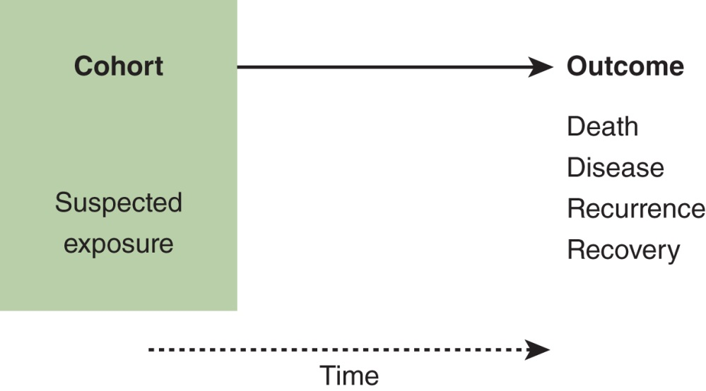
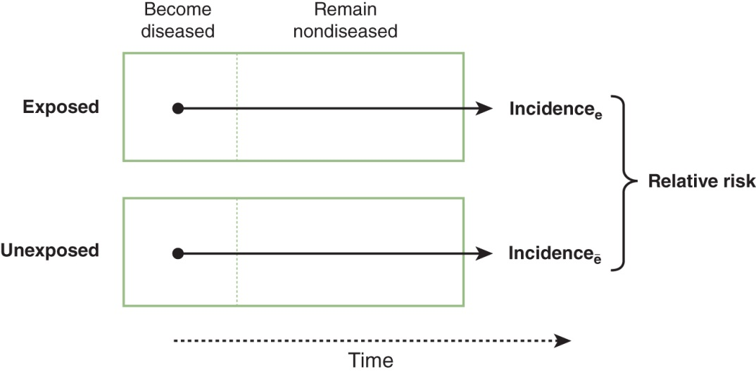
Cohort Studies
Figure 1.12: Basic components of a cohort study: exposure, time, and outcome.
Figure 1.14: Basic analytical approach in a cohort study.
S & N Chapter 1
Notes:
This slide demonstrates the basic components of a cohort study. In a cohort study, a group of healthy people, a group of exposed and unexposed people, or a cohort is identified and followed up for a certain time period to ascertain the occurrence of health-related events.

Slide 5
Consideration in the design of cohort studies
Selection of the exposed and comparison groups
Approaches to follow up
Sources of data
Analysis & interpretation (e.g., confounding, bias, loss to follow up, non-response)
Notes:
When we design a cohort study, we will need to consider a number of study components. First, the type of cohort needs to be carefully considered. For the cohort or participants in the cohort, they should be free of disease of interest if possible. If we think of exposed and unexposed populations, both groups should be equally susceptible to disease. Groups should be comparable.
Also, we will need to develop a well-identified study protocols on how to follow the subjects, how to measure the data (exposures, outcomes, and confounding factors) and how we will manage and analyze the data. Diagnostic and eligibility criteria for the disease should be defined well in advance. At the end, all of these steps are critical to produce valid results that help investigators answer study questions or fulfill study objectives.

Slide 6
Cohort?
Select the cohort on the basis of exposure
General: a certain geographical area (e.g., Framingham Heart Study)
Special-exposure groups
Occupational status (e.g., Nurse Health study)
Characteristics that place members at high risk of disease
Logistical advantages (e.g., insurance/prepaid health care plans)
Study population is followed for detection of all incident events of interest
Notes:
A cohort means that “Any designated group of individuals who are followed or traced over a period of time”.
We can create a study population by selecting groups for the study on the basis of whether or not they were exposed. Or we can select a defined population before any of its members to be exposed or before their exposures are identified.
Study populations in cohort studies can be diverse and may include a sample of the general population of a certain geographical area or exposed and non-exposed individuals. Alternatively, cohorts can be formed by “convenience” samples, or groups gathered because of their willingness to participate or because of other logistical advantages, such as make the investigative team easy to follow. Subjects in a cohort are classified according to their exposure status, and the incidence of the outcome of interest is ascertained and compared across exposure categories. A critical element in a cohort study is the ascertainment of events during the study follow-up.

Slide 7
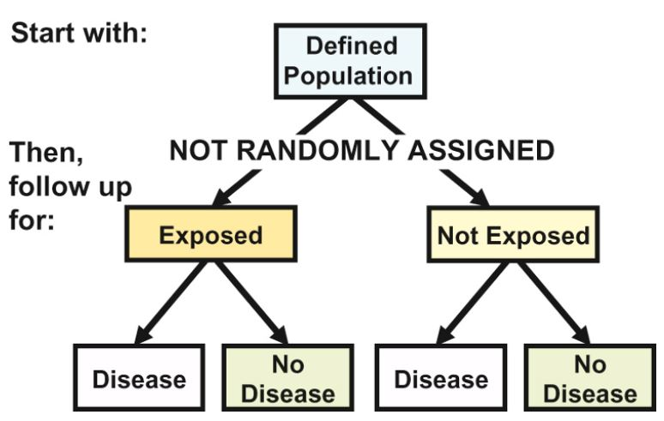
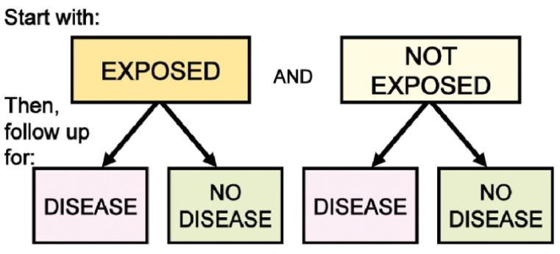
Selection of comparison group
Internal comparison
Only one defined cohort involved in study
Follow up and sub-classified and internal comparison done follow up
External comparison
More than one cohort in the study for the purpose of comparison
Comparison with general population rates
If no comparison group is available we can compare the rates of study cohort with general population
Gordis Epidemiology (6th ed) Figures 8.3 & 8.4
Notes:
Compared with exposure group, the comparison group is part of the whole cohort in the study. Internal comparison can be done between subgroups. We could select a population on the basis of some factor not related to exposure (such as community of residence). Many contemporary cohort studies are designed in this way like Framingham Heart Study. Then we take histories of exposures and conduct blood tests for example on the entire cohort. So for this approach, the exposure of interest may not happen quite a while.
However, if we select more than one cohorts or groups (exposed vs unexposed) for the study, we can compare the exposed group with external unexposed groups. Further if there is no comparison group available, we can also compare the rates/risk of study cohort with that of general population. For example, the cancer incidence in an occupational cohort with exposure, only can be compared with cancer incidence in general population

Slide 8
Open population
May gain and lose members over time – migration, birth, death or certain events that define cohort membership
Person-time formed by a changing group of individuals migrating in and out of the cohort
Notes:
Let’s briefly think of cohort types. There are two types of cohorts: open or closed (sometime called as fixed) cohorts. In open population, or called as dynamic cohort, the study may gain or lose members over time via birth, death or events that define membership. In open population, person-time is formed by a changing group of individuals migrating in and out of the cohort.
Again, a cohort is a group of people that share a common experience. In the simplest cohort study, the exposure would be a permanent and easily identifiable condition, making it easy to assign people to exposed and unexposed groups. However, that is not the case in most real examples.

Slide 9
Closed or fixed cohort
No new members after beginning of the study
Membership ends by death from outcome of interest
Withdrawals from the study are treated as censored outcomes
Loss to follow-up or refusals
Death due to other disease or outcome
Termination of observation
Events that affect risk of disease
Notes:
A fixed cohort or closed cohort does not allow new enrollment. Once the cohort is defined by enrolling subjects and follow-up begins, additional subjects cannot be added to the study. Think of clinical trials as fixed cohort The total number of subjects can only decline in a closed cohort, whereas the total number of participants in an open cohort can fluctuate up or down over time. Exposure groups or individuals are defined at beginning with no movement across groups or no new members are allowed to the study after the initiation of study. Withdrawals such as refusals from the study are treated as censored outcomes.

Slide 10

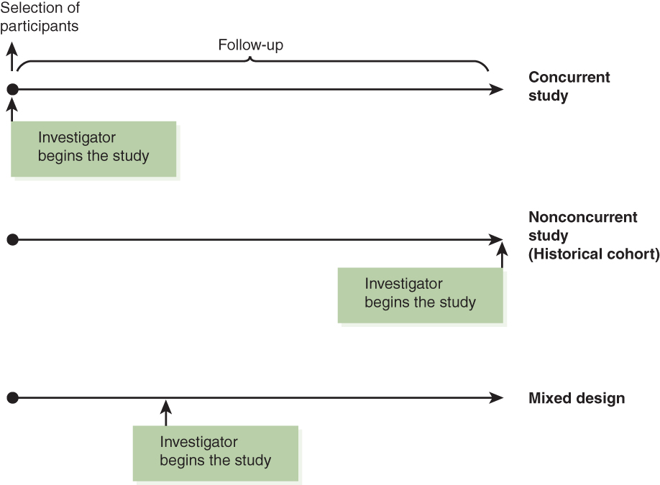
Types of cohort studies according to temporality
Prospective: When study begins, accrual time has not occurred
Retrospective: When study begins, accrual time has already occurred.
Ambi-directional (mixed): Both retrospective and prospective data are collected.
Figure 1.16: Types of cohort studies.
Notes:
Cohort studies are also defined as concurrent (or truly “prospective” as mentioned in S & N textbook) when the cohort is assembled at the present time—that is, the calendar time when the study starts and the cohort is followed up toward the future. The main advantage of prospective cohort studies is that the baseline exam, methods of follow-up, and ascertainment of events are planned and implemented for the purposes of the study from the beginning. Additionally, quality control measures can be implemented as needed.
In retrospective cohort studies (also known as historical or non-concurrent cohort studies), a cohort is identified and assembled in the past on the basis of existing current records and is supposed to be “followed” to the present time. The present time mean the time when the study is conducted. Retrospective cohort studies are less expensive and can be done more easily than prospective studies.
The only difference between prospective and retrospective studies is calendar time, but the designs are identical by comparing exposed and unexposed populations.
Mixed designs or ambi-directional studies with both prospective and retrospective follow-up components are also possible.

Slide 11
Prospective vs Retrospective Cohort Studies
Prospective
Retrospective
Advantages
Measurements are made for purposes of study
Can implement quality control measures in real time
Disadvantages
Expensive and a lot of resources
Time of study is longer than time of observation
Advantages
Can link data to cancer or mortality registries
Less expensive
Can have quick turnaround (less study duration)
Disadvantages
Reliance on existing data (medical records, employment data)
Notes:
The disadvantages of prospective study are the amount of time needed to conduct them. Imagine that we need to follow study participants for long time to have a sufficient number of events to be accumulated. Thus it is quite expensive to conduct. Retrospective is cheaper and quicker than prospective and is more efficient for studying outcomes with long latent periods. The main disadvantage is that the investigators have to rely on available information; as a result, the type or quality of exposure or outcome data may not be well suited to fulfill the study objectives. Thus, data on past exposure may not be available or may be incomplete retrospectively. Again, information on potential confounders also not available, retrospectively.

Slide 12
Selecting appropriate individuals for retrospective cohort study
Must sample persons from the baseline point of the retrospective cohort study regardless of presence in database currently
Allows the researcher to study the outcome, including losses to follow-up from baseline forward
If you select only persons in the database currently, this is NOT a retrospective cohort study
Cross-sectional study by definition
No loss to follow up included in study
Notes:
One thing to remember in conducting a retrospective cohort study is that we have to sample individuals from the baseline (as a cohort) regardless of presence in current database. This will enable us to study the outcome in relation to follow-up period. If we select individuals only in current database even though you are looking at baseline data, that is not a retrospective cohort study. To distinguish whether we are conducting a cross-sectional study and retrospective study, we will need to think of whether we have for example, loss-to-follow up information included in the study.

Slide 13
Questions
A researcher wants to study the association between colorectal cancer and obesity by studying individuals within a healthcare system using the weight history on medical records from previous clinic visits. What study design is this?
Prospective cohort study
Retrospective cohort study
Mixed design cohort study
Notes:
Let’s think of one example. A researcher wants to study the association between colorectal cancer and obesity by studying individuals within a healthcare system using the weight history on medical records from previous clinic visits. What study design is this? The first choice of answer will be retrospective study, but mixed design cohort could also be appropriate.
Based upon wording of the question, If the researcher wanted to study the association forward in time, but use medical records in the past, it would be mixed.

Slide 14
Part 2 – Study design element (Exposure)

Slide 15
Obtaining data on exposure
Personal interviews/mailed questionnaire
Reviews of records
Dose of drug, radiation, type of surgery, etc.
Medical examination or special test
Blood pressure, serum cholesterol
Environmental survey
By obtaining exposure data we can classify members of cohort or cohorts as
Exposed and unexposed
Degree of exposure can allow sub-classification of cohorts
Notes:
To carry out a cohort study, we must have some idea of which exposures are suspected a priori as possible causes of a disease in general, and are therefore worth investigating. Evidence can be gathered from case reports, cross-sectional studies, case-controls or ecologic studies. Consequently, a cohort study is indicated when good evidence suggests an association of a disease with a certain exposure or exposures. To assess the exposure, a number of assessment methods can be used. Simply, by obtaining exposure data, we can classify members into exposed and unexposed groups to compare them.

Slide 16
Exposure can vary over time
Current level of exposure
Average level of exposure
Cumulative level of exposure
Exposure sequence
Modern Epidemiology 3rd ed p105
Notes:
Let’s think of exposure in ‘duration’, ‘concentration’ and ‘frequency’. In Modern Epidemiology chapter 7, Drs. Rothman and Greenland explain attributes of exposure well in the context of cohort studies.
In the simplest cohort study, the exposure would be identified as “permanent”, something we can easily label it (yes or no, or binary), or occurring only once. Race, or low birthweight are permanent exposures. Smoking, neighborhood poverty, stress, are alcohol consumption are exposures that can change over time. Also, oftentimes we are interested in quantity, intensity and frequency of exposures. For example, we can ask participants, do you smoke? How much? How often? and How long? Furthermore, the sequence or timing of exposure can be important. Certain exposures, maternal drinking, during fetal development may impact the outcome differently depending on the exposure occur during 1st trimester compared with 3rd trimester. All these explain complex natures of identifying the exposures. Exposure summaries include current level, average level and cumulative exposure in relation to each exposure level multiplied by the time spent at that level. However, most often a single summary of exposure is used in studies.

Slide 17
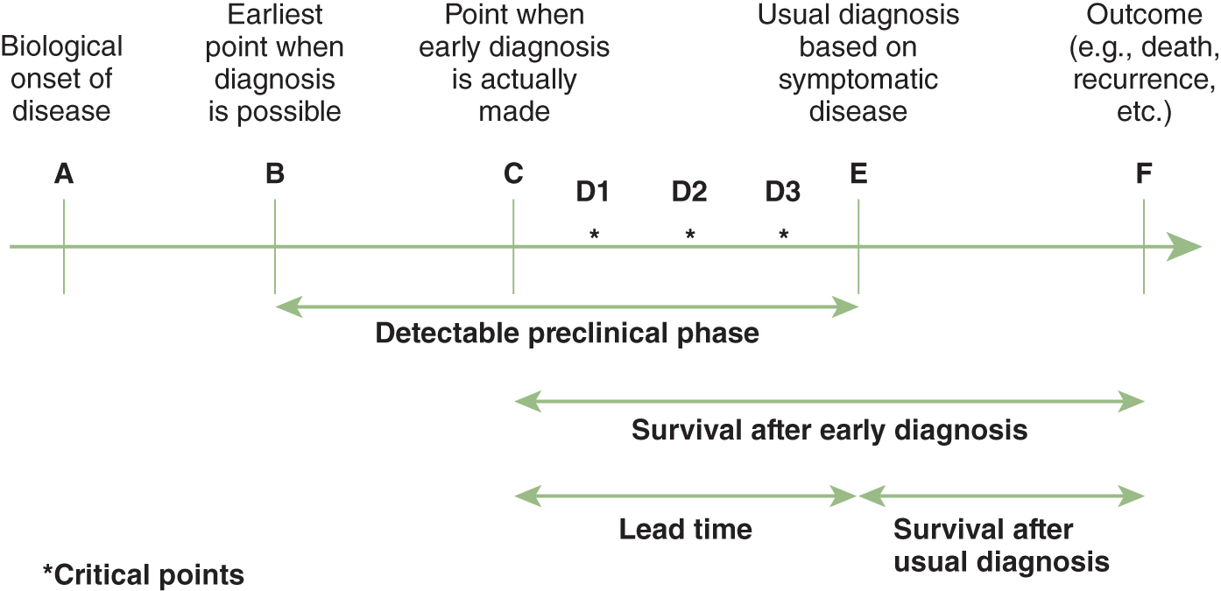
Natural history of a disease - Screening
Screening Interventions
DPCP
Notes:
Let’s recall some key concepts related to the natural history of a disease and screening for length bias and lead time bias as we learned form Module 6 B. In this slide, we are looking at the disease onset and afterward.

Slide 18
Natural history of a disease - Exposure
Exposure
Exp
Induction period
Latent period (A-E, A-B, or A-C depending on detection mechanisms)
Notes:
Let’s tie the previous figure to the exposure or a risk factor prior to the onset of disease. Recall that induction period means time between exposure to a specific risk factor or exposure and the initiation of the disease. Generally the longer the induction period, the more difficult is to assess the association between the risk factor(s) and the disease or outcome and thus the evaluation of causality.
Latent period means that time between biologic onset of disease and disease detection by clinical diagnosis because of clinical signs or by some sort of diagnostic test for subclinical diseases. Some disease such as bacterial infection have short natural disease history (or short induction period or latent period) while other diseases such as cancer have long natural history and long latent period depending on screening or clinical diagnosis tools. Because cohort studies often involve follow-up of populations over a long period, the cohort approach is particularly attractive when we can minimize attrition (losses to follow-up) of the study population. So those cohort studies are generally easier to conduct when the induction period and latent period, or sum of induction period and latent period (i.e., empirical induction period) are short.
The problem with induction period and latent period is related to how we calculate the person time. “What time should we include for a given individual in the denominator of the incidence rate in relation to induction time? “
Think of case-control studies. From Module 10, we know that case-control studies have advantages of studying outcomes with long induction or long latent period. Let’s recap that argument in light of cohort study design.

Slide 19


Study design: cohort studies
ARIC study: https://www2.cscc.unc.edu/aric/Cohort_Description
Hispanic Community Health Study/Study of Latinos (SOL): https://sites.cscc.unc.edu/hchs/StudyOverview
Multi-Ethnic Study of Atherosclerosis (MESA):
https://www.mesa-nhlbi.org/aboutMESAOverviewProtocol.aspx
The Coronary Artery Risk Development in Young Adults (CARDIA) study: https://www.cardia.dopm.uab.edu/
International Childhood cardiovascular cohort Consortium (i3C): http://www.i3cconsortium.org/cohorts.html
The Cameron County Hispanic Cohort (CCHC) study: https://sph.uth.edu/research/centers/hispanic-health/
Notes:
You are already familiar with this slide, which was included in cross-sectional study. Please visit these websites to see how the studies were designed and have been conducted. Most cohort studies, sponsored by National Institute of Health, published their study rationale, study design and methodologies of selecting cohort and measurement protocols. As examples, two articles in your reading list describe how the multi-center investigator teams and the National Heart, Lung and Blood Institute (NHLBI) and six other institutes came together to initiate the Hispanic Community Health Study/Study of Latinos in 2006.

Slide 20
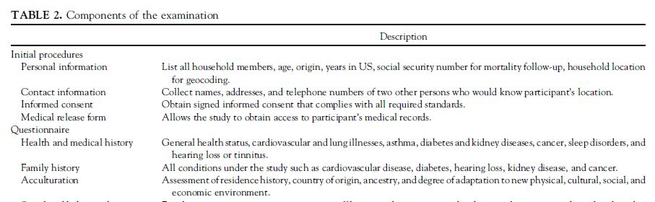
Study design: HCHS/SOL
Study aims or goals
To address burden of chronic diseases, mainly cardiovascular disease and others (e.g., stroke, chronic obstructive lung disease, sleep disorders), and to examine the risk factors related to development of these chronic diseases within context of acculturation
Selection of cohorts
Probability based samplings
Recruitment from 4 geographic areas with different racial backgrounds
Assessment of exposure and outcomes
Sorlie PD et al., Ann Epidemiol 2010;20:629-41. PMC2904957
Notes:
The HCHS/SOL is a prospective, population-based, cohort study consisting of a baseline examination lasting approximately 7 hours, a follow-up telephone call within 6 weeks with a second 24-hour dietary recall, and annual follow-up telephone calls to ascertain any hospitalizations and other significant clinical events and to update participants’ contact information. In Sorlie et al. paper, study aims or study goals, important components of study designs and study protocols are well listed. Selection criteria of cohort were based on two objectives: “1), the study sample must support estimates of prevalence of baseline risk factors, both overall and by Hispanic/Latino background and other demographic subgroups. 2), the sample must support evaluation of the relationships between the various risk factors and disease outcomes measured during follow-up.” according to Lavanage et al.
Cohort individuals were selected based on two stage probability based sampling strategies that employed census block groups with strata based on socioeconomic status and individual household information with focus of recruiting specific ethnic/racial background participants from each of four study sites (San Diego, Chicago, Bronx, Miami). For example, majority of participants in San Diego identified themselves as Mexican Americans. Adults participants aged between 18-74 were recruited and underwent an extensive clinic exam. So far, there have been two follow-up based on clinic examination baseline visit between 2008-2011 and 2nd visit between 2015-2017.
As you can see in Table 2, Table 3, and Table 4 (Sorlie et al., 2010), the protocols on how exposure and outcomes were developed and implemented in great details. If you are interest in, HCHS/SOL data book: A report to the communities (https://sites.cscc.unc.edu/hchs/StudyOverview) will give you an great overview of the study.
Reference: Sorlie PD et al., Design and implementation of the Hispanic Community Health Study/Study of Latinos. Ann Epidemiol 2010;20:629-41. PMC2904957
Lavange LM et al., Sample design and cohort selection in the Hispanic Community Health Study/Study of Latinos. Ann Epidemiol. 2010;20:642-9. PMC2921622

Slide 21

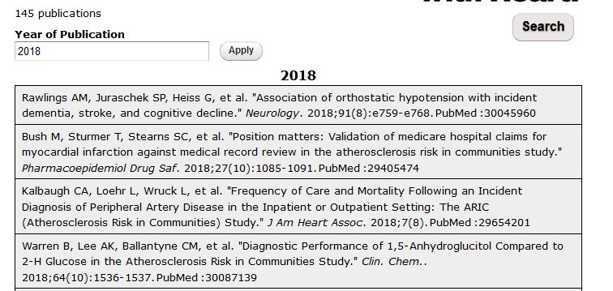
Studies of multiple exposures and multiple outcomes
Cohort and Community Surveillance Components
1987 1988 1989 1990 1991 1992 1993 1994 1995 1996 1997 1998 1999 2000 2001 2002 2003 2004 2005 2006 2007 2008 2009 2010 2011 2012 2013 2014 2015 2016 2017 2018 2019 2020 2021
Exam 1 n=15,792 |  | Exam 2 n=14,348 |  |  | Exam 3 n=12,887 |  |  | Exam 4 n=11,656 |  |  |  |  |  |  |  |  |  |  |  |  |  |  | Exam 5 n=6,538 |  |  |  |  | Exam 6 n= 4,214 |  |  | Exam 7 n~ 3,700
 | CY2 |  | CY 5 |  |  | CY 8 |  |  | CY 11 |  |  | CY 14 |  |  | CY 17 |  |  | CY20 |  |  | CY 23 |  |  | CY 26 |  |  | CY 29
 |  | CY 3 |  |  | CY 6 |  |  | CY 9 |  |  | CY 12 |  |  | CY 15 |  |  | CY 18 |  |  | CY 21 |  |  | CY 24 |  |  | CY 27 |  |  |  | CY 30
 |  |  |  | CY 4 |  |  | CY 7 |  |  | CY 10 |  |  | CY 13 |  |  | CY 16 |  |  | CY 19 |  |  | CY 22 |  |  | CY 25 |  |  |  | CY 28 |  |  |  | CY 31
Cohort Exams
Annual Follow-Up
(Contact Years)
https://sites.cscc.unc.edu/aric/study_design
Notes:
If you browsed through studies with longer histories than Study of Latinos, you will see how multiple exposures and multiples outcomes have been examined in cohort studies like SOL, A lot of faculty in our school have been involved with Atherosclerosis Risk in Communities Study (ARIC). ARIC study is in its 7th cohort exam cycle. Genomics, life style factors, sleep durations and various exposures and their relationships with multiple outcomes, cardiovascular disease, cognitive decline, dementia and Alzheimer disease and others have been studied in the cohort. In 2018 alone, 145 manuscripts were published on the relationships between various outcomes and exposures according to study website (https://sites.cscc.unc.edu/aric/view/biblio/year?biblio_year=2018).

Slide 22
Part 3 – Incidence based on individual at risk Incidence based on person-time

Slide 23
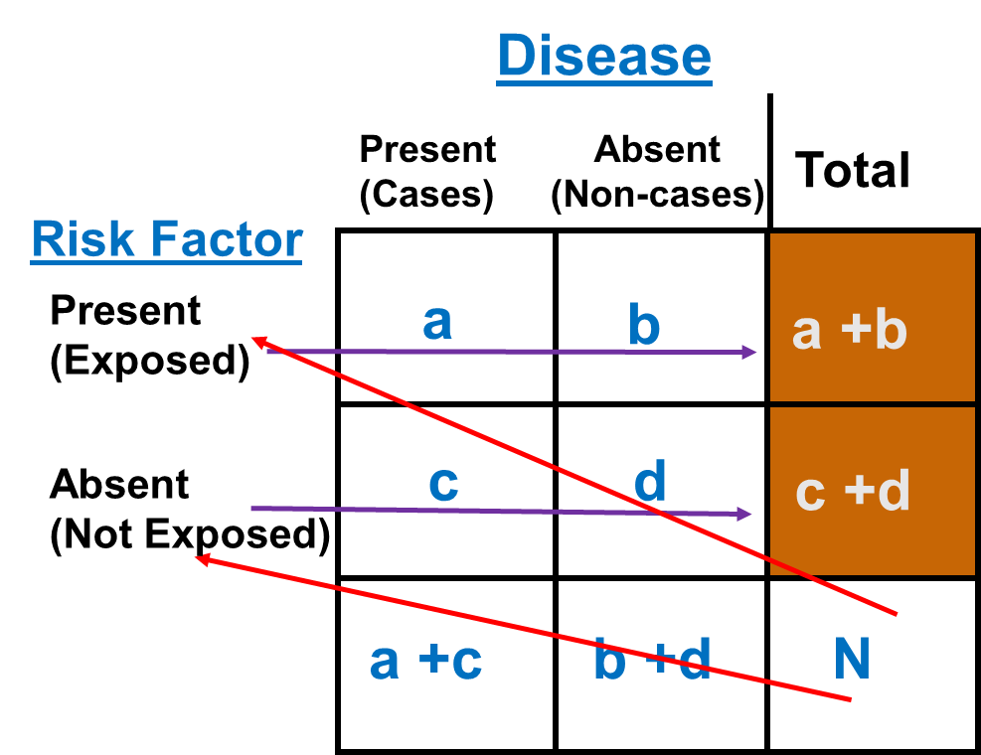
Rothman, Epidemiology: An Introduction 2nd Ed. pp 164-170
Notes:
Let’s switch the gears a little bit and talk about cohort data analysis. You already seen this slide from Module 2. This conventional 2 x 2 table illustrates the cohort study design. In the simplest cohort study design, two groups (exposed and unexposed) are recruited and compared for the presence of disease outcomes. Again, in many large cohort studies, study begins with a total sample of N (selection of cohort). Once we obtain the exposure status, study participants will be placed into exposed group (marginal, noted as a + b) and unexposed group (marginal, noted as c + d). Then we follow these members to ascertain outcomes of interest with multiple visits sometimes.

Slide 24
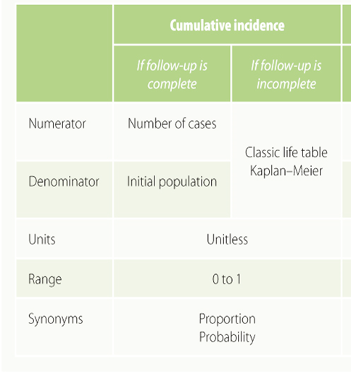
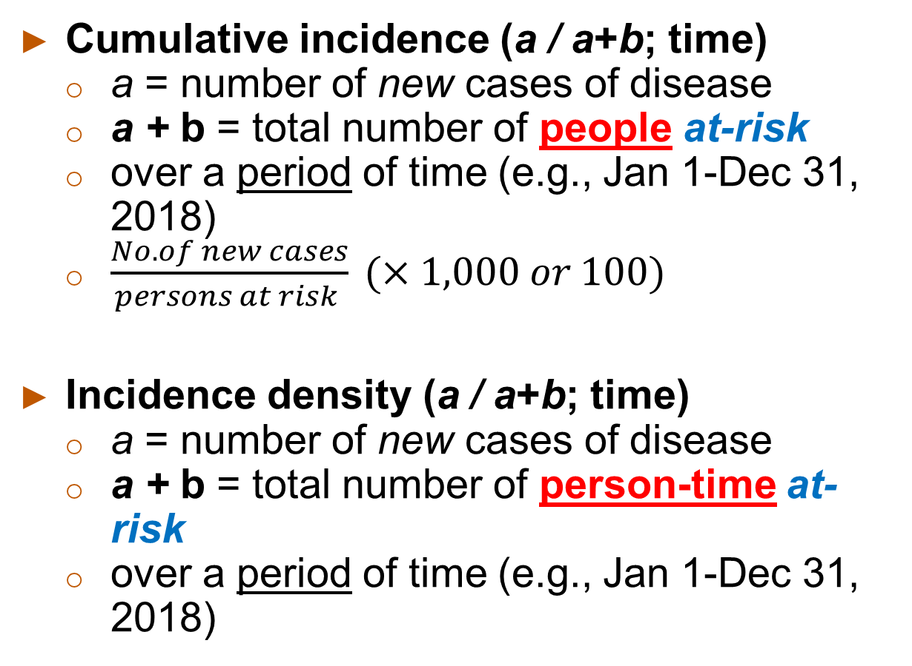
Incidence
Cumulative incidence (a / a+b; time)
a = number of new cases of disease
a + b = total number of people at-risk
over a period of time (e.g., Jan 1-Dec 31, 2018)
$\frac{No. of new cases}{persons at risk } (×1,000 or 100)$
Incidence density (a / a+b; time)
a = number of new cases of disease
a + b = total number of person-time at-risk
over a period of time (e.g., Jan 1-Dec 31, 2018)
S & N textbook p 77
Notes:
Incidence represents new cases of disease that develop over time. In doing so, it describes the rate of development of disease in a population. Incidence can be especially helpful in investigations specific to the etiology of a disease. What causes the onset and/or progression in disease or other health-related outcome? Incidence is the measure of disease occurrence that is particularly well-suited to answering this question. Again, you should be very familiar with the formulae for calculating incidence.
Incidence has been traditionally used to indicate a proportion of newly developed (incident) cases of a disease; however, this measure can be used to characterize the frequency of any new health- or disease-related event. There are two types of measures of incidence defined by the type of denominator: (1) incidence based on persons at risk and (2) incidence based on person-time unit at risk.
Cumulative incidence directly measures the risk of developing the disease – while incidence density considers the rate, or velocity, at which disease occurs. The numerator is the same for both calculations, while the denominator differs. We saved our conversation on incidence density for cohort studies.

Slide 25

Incidence based on individuals at risk
Cumulative incidence – survival analysis
No loss-of-follow-up
Cumulative incidence = # of events/ initial population during the follow up
= incidence based on persons at risk
Losses of follow-up
Outcome of event vs. censored observations = loss of follow-up (collectively)
Cumulative survival (or survival function) with censored observations
Life table of the actuarial type (interval based life table)
Kaplan-Meier method
Cumulative incidence
Cumulative survival
Notes:
Cumulative incidence is the basis for the statistical techniques known as survival analysis. If follow-up is complete on every individual in the cohort, in other words “no loss of follow up” the estimation of the cumulative incidence is simply the number of events occurring during the follow-up time divided by the initial population.
Oppositely, in real situation, there are individuals lost to follow-up, those dying from causes other than the outcome of interest, and those whose follow-up is shorter because they are recruited later in the accrual period for the study. All these losses to follow-up are called censored observations
Life table and Kaplan-Meier method is usually used to estimate cumulative incidence (it complement, cumulative survival or survival function)

Slide 26

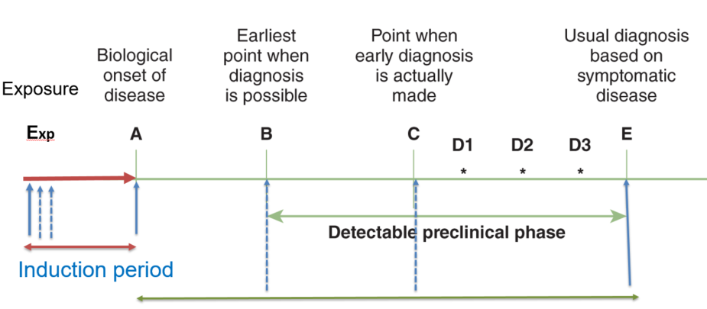
Incidence based on person-time
Two components to calculate incidence rate: 1) # of new cases and 2) person-time at risk
Induction periods (time exposed vs time at risk)
in the denominator is linked to assumptions about induction time.
Contribution to person-years at risk begins when induction time begins.
Notes:
To calculate incidence rate/density, we will need two main components: 1) number of new cases and 2) actual person time at risk. Person-time at risk is an estimate of the actual time at risk according to “ERIC notebook (see reference)” In other words, a subject is eligible to contribute person-time to the study only when that individual does not have the health outcome of interest or is still at risk of developing the health outcome.
According to Modern Epidemiology, “Time at risk” is the time that an individual contributes to the denominator of the incidence rates in a cohort study. We will need to distinguish that ‘time exposed or time during which exposure occurs‘ is different from ‘time at risk. In occupational cohort studies of exposure to certain levels of noise and CVD, for example, time of employment means the time (duration) exposed to the exposure whereas ‘’time at risk for exposure effect” generally comes after the accumulation of occupational noise exposure like shown in the figure. Time at risk for exposure effects can occur even if the workers quit their job. So the person time (time at risk) is linked to assumptions about induction time. In previous module, we discussed the induction time.
Reference: https://sph.unc.edu/files/2015/07/nciph_ERIC4.pdf

Slide 27
How to calculate person-time
Researchers are studying the rate of developing asthma. The researchers enroll 100 participants who have been determined to not have asthma. The researchers plan to follow these participants over one year to see who develops asthma, beginning on January 1st. Participants visit a doctor monthly, at the end of the month, to determine if they have asthma. After one year, 5 of the participants have developed asthma. See below table.
# of new cases at the end of 1 year study period: 5 cases
Person time: ‘person months’ will be calculated
(100 – 5) subjects * 12 months = 1140; 2 subjects * 3 months = 6; 2 subjects * 8 months = 16; 1 subject * 11 months = 11 ➔ Sum: 1173 person-months
Incidence rate of asthma: (# of new cases)/total person time at risk = 5/1173 = 0.0043 or 4.3 per 1,000 person-months.
 | Jan | Feb | Mar | Apr | May | Jun | Jul | Jul | Aug | Sep | Oct | Nov | Dec | Total
Sub | 0 | 0 | 2 | 0 | 0 | 0 | 0 | 0 | 2 | 0 | 0 | 1 | 0 | 5
https://sph.unc.edu/files/2015/07/nciph_ERIC4.pdf
Notes:
Let’s focus on how to calculate person-time using a simple example. This example is a practice question from UNC ERIC notebook.
Based on this calculation, incidence rate for asthma for some exposure is 4.3 per 1,000 person months.
Reference: https://sph.unc.edu/files/2015/07/nciph_ERIC4.pdf

Slide 28
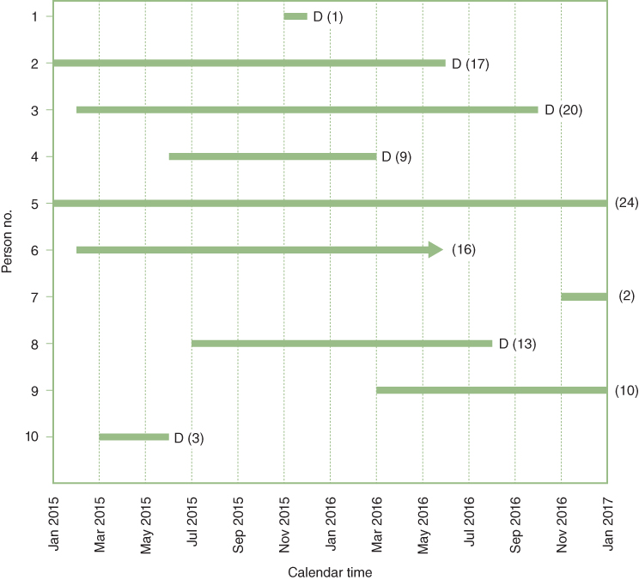
Hypothetical example
Follow up of 10 patients for 2 years
6 Deaths
3 censored before 2 full years of follow-up
1 survived for 2 full years
Question: What is the cumulative Incidence of death (or the cumulative survival) up to 2 years?
SOURCE: Szklo & Nieto (2019)
Notes:
Recall this slide? We used this hypothetical example in Module 2.
The example is provided in our S & N textbook. Data are from a hypothetical cohort of 10 people who are followed over time (up to 24 months or two years), from January 2015 through January 2017. In Module 2, we calculated the cumulative incidence.
Let’s use this example to first calculate the person time at risk.

Slide 29
Example: 2 year cumulative probability death
Reorganize our example:
 |  | Contribution to the total number of person yrs by participants in:
Person No. | Total follow-up (months) | 1 yr. of follow up | 2 year of follow up | Total follow up period
1 | 1 | 1/12 = 0.083 | 0 | 0.083
2 | 17 | 12/12 = 1.000 | 5/12 = 0.417 | 1.417
3 | 20 | 12/12 = 1.000 | 8/12 = 0.667 | 1.667
4 | 9 | 9/12 = 0.750 | 0 | 0.750
5 | 24 | 12/12 = 1.000 | 12/12 = 1.000 | 2.000
6 | 16 | 12/12 = 1.000 | 4/12 = 0.333 | 1.333
7 | 2 | 2/12 = 0.167 | 0 | 0.167
8 | 13 | 12/12 = 1.000 | 1/12 = 0.083 | 1.083
9 | 10 | 10/12 = 0.833 | 0 | 0.833
10 | 3 | 3/12 = 0.250 | 0 | 0.250
Total | 115 | 7.083 years | 2.500 years | 9.583
Notes:
For our example, the person time or person years for the denominator is calculated as 9.583 years.

Slide 30

Example: 2 year cumulative probability death
Step 1: Calculate denominator, i.e. units of time contributed by each individuals, and total (e.g., 9.583 years)
Step 2: Calculate rate per person-year for the total follow-up period:
For our example
$$Incidence density \left(rate\right)= \frac{6 events}{9.583 years}=0.63 per person years$$
Notes:
If we re-use our example to calculate person time, we can follow two steps to calculate total person time.
We have 6 events. If you recall, incidence density or rate is based on number of events divided by person time or person at risk.
So, it is possible for us to calculate the incidence rates per person-years for overall period i.e., 2 years in this example, or to calculate separately for shorter periods during the follow-up, such as year 1 and year 2. More detailed information how to calculate person time on next slide.

Slide 31
Notes
Rates have units (time⁻¹).
Proportions (e.g., cumulative incidence) are unitless.
As velocity, rate is an instantaneous concept. The choice of time unit used to express it is totally arbitrary. Depending on this choice, the value of the rate can range between 0 and ∞.
E.g.: 0.024 per person-hour = 0.576 per person-day
= 210.2 per person-year
Notes:
A couple of notes on incidence rate (or density) based on person-times. Incidence rates are not proportions.
They are obtained by dividing the number of events by the amount of time-at-risk (pooling all study participants) and are measured in units of time^{–1}. As a result, a rate can range from 0 to infinity, depending on the unit of time being used.
The time unit used depends on investigators and is usually selected on the basis of the frequency of the event under study. The main reason that many epidemiologic studies use person-years as the unit of analysis is because it is a convenient way to express rare events. When one is studying relatively frequent health or disease events, it may be more convenient to use some other unit of time like person-weeks for influenza epidemic to calculate incident cases of influenza.

Slide 32
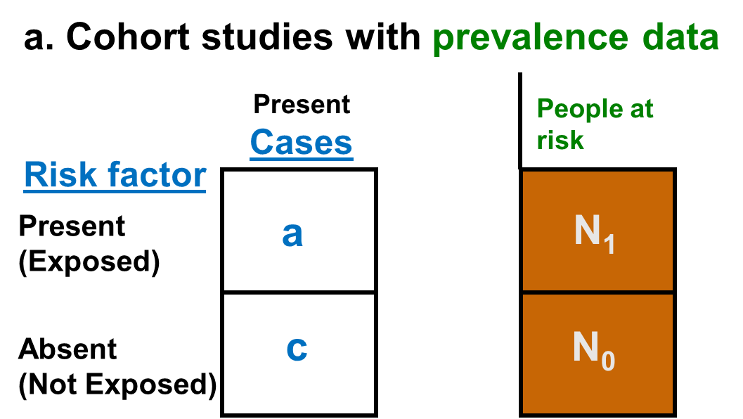
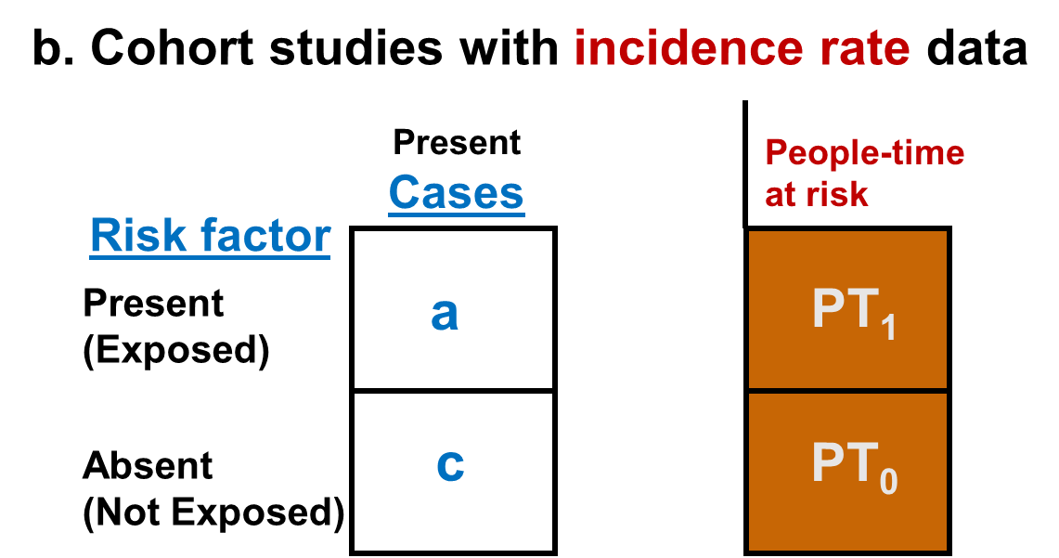
Rothman, Epidemiology: An Introduction 2nd Ed. pp 164-170
Notes:
Let’s tailor this conventional 2 x 2 table to include appropriate information to measures the effect of an exposure in cohort studies.
If a cohort study followed all subjects for a fixed period of time and there were no other important competing risk factors and no confounding, we could display the captured data as shown in Table a.
For a cohort study that allow for different follow-up periods for each subject, we could measures incidence rates and the data can be displayed as shown in Table b.

Slide 33
Measures of association used in a cohort study
Relative differences
Risk ratio: ratio of two cumulative incidences between exposed and not exposed groups
-Risk ratio of cumulative incidence (CIR) = [a / N₁] / [c / N₀]
Rate ratio: ratio of two incidence densities or incidence rates
– Rate ratio of incidence rate (IRR) = [a / PT₁ ] / [c / PT₀]
Odds ratios: ratio of two odds
A measure of the strength of the association between a factor and an outcome
Also applies to other related association measures
Hazard ratio
Absolute risk difference (attributable risk) between two incidence probabilities
- A measure of the public health impact of the risk factor, and it focuses on the number of cases that could potentially be prevented by eliminating the risk factor
Notes:
Frequently, a term "relative risk" is used to encompass risk ratio and rate ratio as well. These relative measures give an indication of the "strength of association.“ Risk ratio is the ratio of the cumulative incidences in the exposed and unexposed groups. Rate ratio is the ratio of incidence rates or density in the exposed and unexposed groups. Please see the numerators and denominators in Table a and Table b on slide 20. For example, the incidence rate ratio can be calculated as follows: a ratio between cases (a) divided by people time at risk (PT₁) in the exposed group and cases (c) divided by people time at risk (PT₀) in the unexposed group.
An alternative definition of an instantaneous incidence rate (density) is the hazard rate. In the context of a cohort study, the hazard rate is defined as each individual’s instantaneous probability of the event at precisely time t (or at a small interval [t, t+Δt]), considering the fact that the individual was at risk at time t. The hazard rate is defined for each particular point in time during the follow-up. Hazard ratio is the ratio of hazard rate and will be explained using survival analysis technique. We will review a little bit more of life table, survival curve and cox-proportional regression model in a different module slides.
Absolute risk difference or attributable risk in the exposed is often used to study the public health impact of the risk factor on outcome.

Slide 34
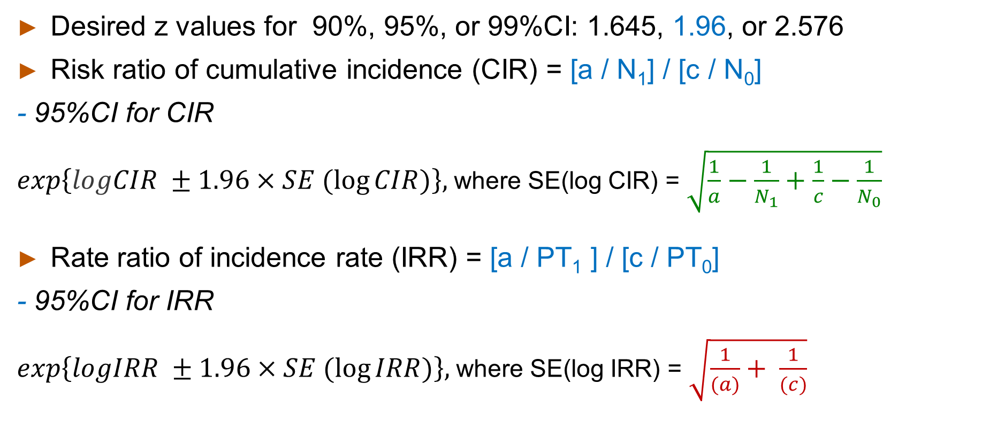
(1-alpha)%Confidence Interval
Desired z values for 90%, 95%, or 99%CI: 1.645, 1.96, or 2.576
Risk ratio of cumulative incidence (CIR) = [a / N₁] / [c / N₀]
- 95%CI for CIR
$exp\left\{logCIR ±1.96×SE (\log{CIR)}\right\},$where SE(log CIR) = $\sqrt{\frac{1}{a}−\frac{1}{N_{1}}+\frac{1}{c}−\frac{1}{N_{0}}}$
Rate ratio of incidence rate (IRR) = [a / PT₁ ] / [c / PT₀]
- 95%CI for IRR
$exp\left\{logIRR ±1.96×SE (\log{IRR)}\right\},$where SE(log IRR) = $\sqrt{\frac{1}{(a)}+ \frac{1}{(c)}}$
‘Log’ = natural logarithm
Rothman, Epidemiology: An Introduction 2nd Ed. pp 164-170
Notes:
Using the equations in this slide, we can calculate the interval estimates of cumulative incidence risk ratio (CIR) or incidence rate ratio (IRR) as well.

Slide 35
Example: Cumulative incidence for 20 year follow-up
Cumulative incidence for those exposed to SHS: ?
Cumulative incidence for those NOT exposed to SHS: ?
CIR = ?
95%CI for CIR: ?
Interpretation of CIR and 95%CI for CIR?
Second hand smoking (SHS) (exposure) | N of myocardial infarction (Cases) | People at risk
Yes | 120 | 20,000
No | 90 | 23,000
Notes:
Let’s calculate cumulative incidence using an example. Consider that the investigators are examining the relationship between second-hand smoking exposure due to spousal smoking and heart attack in postmenopausal women over the 20 year period of observation. Please calculate the cumulative incidence risk ratio and 95%CI of CIR

Slide 36
Example: Cumulative incidence for 20 year follow-up
Second hand smoking (SHS) (exposure) | N of myocardial infarction (Cases) | People at risk
Yes | 120 | 20,000
No | 90 | 23,000
Cumulative incidence for those exposed to SHS: 120/20,000 = 6.0 per 1000 or 0.0060
Cumulative incidence for those NOT exposed to SHS: 90/23,000
= 3.913 per 1000 or 0.0039
CIR = 0.0060/0.0039 = 1.533 for 20 year follow-up
95%CI for CIR: exp{log*(1.533) ± 1.96*0.139} ~= exp{0.154, 0.701} ~ (1.167, 2.015)
Log means natural logarithm function (i.e., ln)
http://sphweb.bumc.bu.edu/otlt/MPH-Modules/QuantCore/PH717_ComparingFrequencies/PH717_ComparingFrequencies9.html
Notes:
Based on cumulative incidences for exposed and not exposed group to second hand smoking, the cumulative incidence ratio is about 1.533 suggesting that post-menopausal women who were exposed to spousal second hand smoking had 1.533 times the risk of having MI compared to post-menopausal women who were not exposed to second hand smoking over the 20 year period of observation. Based on this CIR, we are 95% confident that the true risk ratio falls between 1.167 and 2.013. Or the harmful effect of SHS ranges from a 17% higher risk to a 101% higher risk, measured in relative terms.

Slide 37
Example: Incidence rate
The Nurses Health Study
Incidence rate for those exposed to HRT: ?
Incidence rate for those NOT exposed to HRT: ?
IRR = ?
95%CI for IRR: ?
Interpretation of IRR and 95%CI for IRR ?
Post menopausal HRT use | N of coronary artery disease (cases) | Person-years of follow-ups (people-time at risk)
Yes | 30 | 54,308.7
No | 60 | 51,477.5
http://sphweb.bumc.bu.edu/otlt/MPH-Modules/QuantCore/PH717_ComparingFrequencies/PH717_ComparingFrequencies9.html
Notes:
Let’s use the example from Nurses’ Health Study (NHS) copied from Boston University course.
Consider that NHS investigators are examining the effects of hormone replacement therapy (HRT) on heart disease in post-menopausal women.
Please try to calculate IR, IRR and 95%CI for IRR.

Slide 38
Example: Incidence rate
Post menopausal HRT use | N of coronary artery disease (cases) | Person-years of follow-ups (people-time at risk)
Yes | 30 | 54,308.7
No | 60 | 51,477.5
Incidence rate for those exposed to HRT: 30/54308.7 = 55.2 per 100,000 person years
Incidence rate for those NOT exposed to HRT: 60/51,477.5 = 116.6 per 100,000 person years
IRR = 55.2/116.6 = 0.474
95%CI for IRR: exp{log(0.474) ± 1.96*0.224} = exp{-1.184, -0.308} → (0.306,0.735)
http://sphweb.bumc.bu.edu/otlt/MPH-Modules/QuantCore/PH717_ComparingFrequencies/PH717_ComparingFrequencies9.html
Notes:
Based on incidence rates for exposed and not exposed group to HRT, the incidence rate ratio is about 0.474 suggesting that post-menopausal women who used HRT had 0.47 times the rate (or risk) of coronary artery disease compared to post-menopausal women who did not use HRT. Based on this rate ratio, we are 95% confident that the true rate ratio falls between 0.306 and 0.735.

Slide 39
Risk Difference/Rate Difference
The excess risk than can be attributed to having had the exposure
Caution: The term (Attributable risk) presumes a causal relationship but in fact it may represent only an estimate (association) of the causal relationship.
It is useful for the study of the primary prevention or screening impact in clinical practice and public health
Risk difference = cumulative incidence in exposed group – cumulative incidence in unexposed group
Rate difference = Incidence rate (or density) in exposed group - Incidence rate in unexposed group
Notes:
As we already learned from Module 2, the risk difference or absolute difference is to concentrate on the number of cases that could potentially be prevented by eliminating the risk factor. This means that we assume that the relationships between a risk factor (or exposure) and outcome to be causal. However, the significant associations between risk factors and outcomes may not be always causal relationships. Thus, we will need to be cautious when we interpret the risk or rate difference. While the risk difference is calculated by using cumulative incidence, the rate difference is calculated by subtracting the incidence rate in the unexposed group (or least exposed group) from the incidence rate in the group with the exposure.

Slide 40
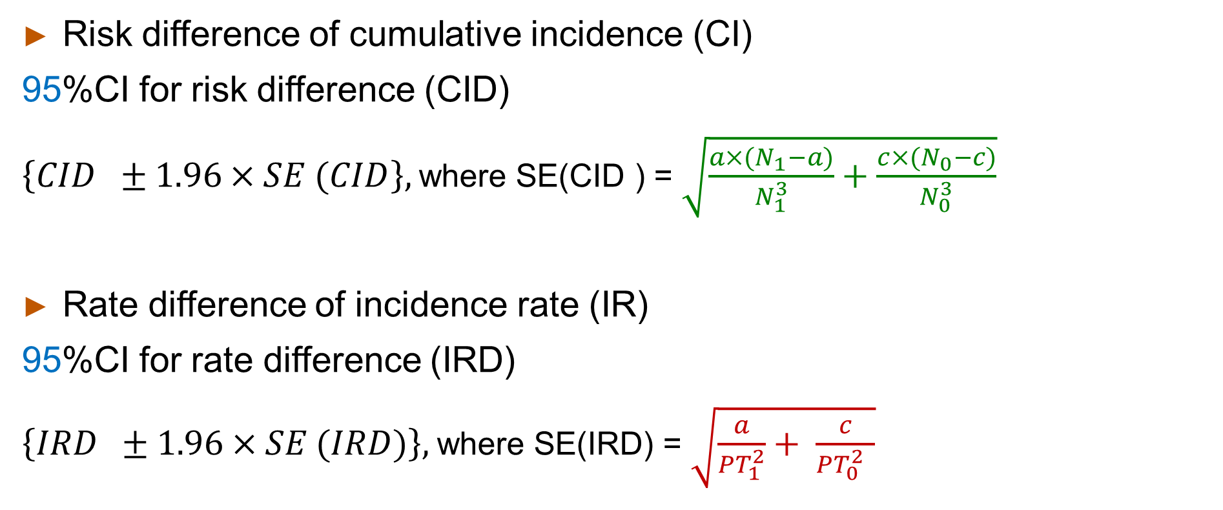
(1-alpha)%Confidence Interval
Risk difference of cumulative incidence (CI)
95%CI for risk difference (CID)
$\left\{CID ±1.96×SE (CID\right\},$where SE(CID ) = $\sqrt{\frac{a×(N_{1}−a)}{N_{1}^{3}}+\frac{c×(N_{0}−c)}{N_{0}^{3}}}$
Rate difference of incidence rate (IR)
95%CI for rate difference (IRD)
$\left\{IRD ±1.96×SE (IRD)\right\},$where SE(IRD) = $\sqrt{\frac{a}{{PT}_{1}^{2}}+ \frac{c}{{PT}_{0}^{2} }}$
Rothman, Epidemiology: An Introduction 2nd Ed. pp 164-170
Notes:
Using the equations in this slide, we can calculate the interval estimates of (cumulative incidence) risk difference or (incidence rate) rate difference between exposed and unexposed group for the outcome. Please note that the confidence interval calculations for risk difference and rate difference do not require exponentiation of lower and upper values.
Reference; Rothman KJ. Epidemiology: An introduction 2nd edition, pp 164-170

Slide 41
Example
Second Hand Smoking and MI example
Risk difference = ?
95%CI for risk difference = ?
HRT and coronary artery disease example
Rate difference = ?
95%CI for rate difference = ?
Notes:
Let’s use our previous two examples to calculate risk difference and rate difference here.

Slide 42
Example
Second Hand Smoking and MI example
Risk difference = 0.00209 or 2.09 per 1000
95%CI for risk difference = 0.00209 ± 1.96*0.000674 → (0.00075, 0.00343)
HRT and coronary artery disease example
Rate difference = -0.000613 or -61.3 per 100,000 person years
95%CI for rate difference = - 0.000613 ± 1.96*0.000181 →
~(-0.000968, -0.000258) ➔ -96.8 per 100,000 person years, -25.8 per 100,000 person years
Notes:
For the first example, we can interpret the risk difference of 2.09 per 1000 as following: Assuming there is a cause-effect relationship, there about 2.09 excess MI cases per 1000 women in the group that were exposed to second hand smoking due to spousal smoking, compared to the group of postmenopausal women who did not exposed to second hand smoking over 20 year follow up. We are 95% confident that the true risk difference lies between 0.7 per 1000 and 3.4 per 1000 excess cases of MI over 20 years.
For the second example, it is a little bit tricky to explain. Post-menopausal women who were exposed to HRT had 61.3 (or 62) fewer cases of CAD per 100,000 person-years compared to post menopausal women who were not exposed HRT. According to this sample, we are 95% confident that true rate difference lies between 96.8 and 25.8 fewer cases of CAD per 100,000 years among women who were exposed to HRT in comparison with women who were not.

Slide 43
Strengths of cohort studies
Allows calculation of incidence.
Time sequence is clear (exposure → outcome).
Allows calculation of all measures of association.
Multiple outcomes can be assessed.
Multiple exposures including rare exposure can be assessed.
New hypothesis can be tested as time goes by.
Efficient way to evaluate associations (stored specimens can be analyzed later).
Can incorporate changes in exposure and confounders over time.
Notes:
Let’s summarize the strengths and weakness of cohort studies to wrap up this module.
The cohort study design is a good design choice for observational epidemiology study. The cohort study design allow investigators to calculate the incidence of a disease and it provide direct measure of association (risk) between the exposure and outcome as well as indirect measure such as odds ratio. Because exposure data are collected prior to the outcome in a cohort study, the temporal sequence of events between the exposure and outcome is quite clear and thus it supports the causal inference we might want to infer from the study. If you already checked out many cohort studies’ websites, you will see that most cohort studies have provided investigators rich resources to assess the multiple outcomes and multiple exposures. Using the case-control studies nested in cohort studies, for example, we can also the test a new hypothesis.

Slide 44
Weaknesses of cohort studies
Time and expense can limit feasibility in prospective studies
Inefficient to study rare disease with long induction periods
Change in exposure level
Potential for biases (e.g., loss-to-follow up) including selection bias.
Notes:
However, in particular, the prospective cohort study will require a long time and enormous expense to carry out. Especially, it may be inefficient to study rare disease with very long induction periods as you can imagine. Also, changes or fluctuations in exposure status or cumulative exposure can be quite challenging in the cohort studies even though this can be dealt with statistical analyses. The cohort is also subject to various biases, which we will review in our next module.

Slide 45

Part 2: Life Table (Interval) Approach Part 3: Kaplan-Meier Curves - Incidence based on individuals at risk
Module 2 A
Notes:
Please check back Module 2 A to refresh your memory on how to calculate cumulative probability of survival using Life Table (interval) approach and Kaplan-Meier method.

Slide 46
Cohort study design
YouTube videos
STATA leaner (edX: Week 7 Cohort study series)
https://www.youtube.com/watch?v=PU3NGMKNj5o&list=PL6p7gIm6aWd_nh7fSOioOIj7qngTDAFRH
Cohort studies chunk 2 – open/close
Cohort studies chunk 3 – pro/retro
Cohort studies chunk 4 – induction/latency
Notes:
More details on cohort studies are well explained on following series of 10 video lectures provided by STATA leaner group.
Please watch the video lectures for your reference, especially segment 2, 3, 4, and Guest speaker lecture on the Nurses’ Health Study if you like

Slide 47

Summary
Cohort studies generally begin with identification of exposed and unexposed groups who are then followed for the event of interest
Persons in cohorts are free of the event at beginning of the study
Selection of participants is flexible
Counting exposure time and time at risk should be defined carefully at study start.
Know advantages and disadvantages of cohort studies
Strengths and limitations
Notes:
Let’s conclude this module by summarizing what we learned about cohort study design. In summary, cohort studies generally begin with identification of exposed and unexposed groups who are then followed for the event of interest. Note that persons in cohorts are free of the event at beginning of the study in general. Selection of participants is flexible but counting exposure status, time and time at risk should be defined carefully in the beginning of the study. There are a number of strengths of using cohort study designs we reviewed already. Also, we will need to remind ourselves of a few limitations including time and cost.

Slide 48

Acknowledgements
This presentation includes some material/examples/slides from:
Szklo & Nieto, Epidemiology: Beyond the Basics. 4th Edition
Rothman, Greenland, & Lash. Modern Epidemiology. 3rd Edition
Celentano & Szklo, Gordis Epidemiology. 6th Edition
edX: Week 7 Cohort studies, Harvard University, School of Public Health https://www.youtube.com/watch?v=PU3NGMKNj5o&list=PL6p7gIm6aWd_nh7fSOioOIj7qngTDAFRH
Notes:
As usual, we will end this lecture with acknowledgments for the sources that helped in making this lecture.

